Slide 1
Summer of NativeScript

Slide 2
Summer of NativeScript
Three meetups worth of material
Introducting NativeScript
Beyond the Basics
Diving Deep
Organize a meetup and we’ll send you stickers.
Share pictures with @nativescript (http://twitter.com/nativescript ) so we can help spread the love.

Slide 3
Meetup #1: Introducing NativeScript

Slide 4
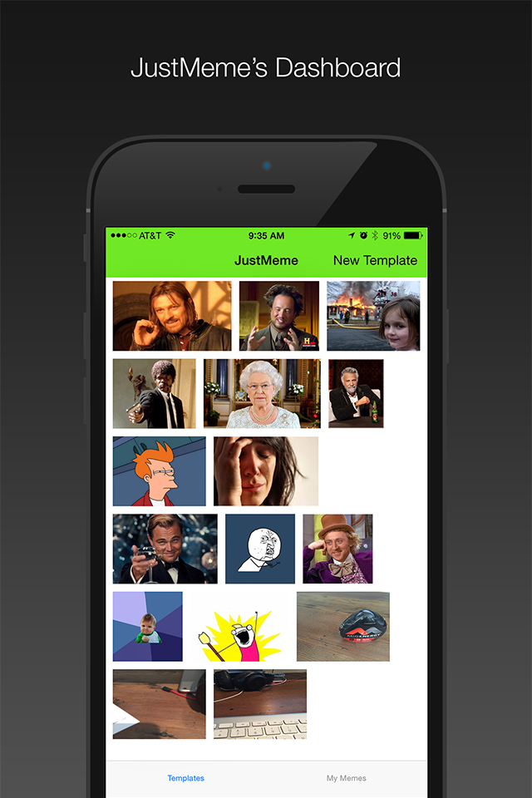

JustMeme
https://github.com/NativeScript/sample-JustMeme

Slide 5


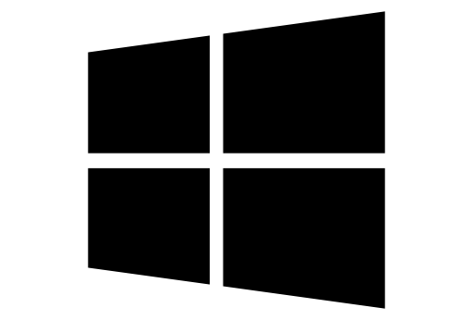
What is NativeScript?
A runtime for building and running native iOS, Android, and (soon) Windows Phone apps with a single, JavaScript code base

Slide 6


Slide 7

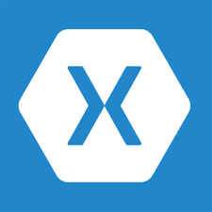


!=
!=
No DOM
No cross compilation
!=
Direct access to native APIs in JS

Slide 8
Why NativeScript?
Skills reuse
Standards-based JavaScript, CSS, optionally TypeScript
Code reuse
npm modules, 3rd-party iOS and Android libraries
Easily use native APIs
No wrappers to access native APIs
Use native UI elements
Open source!

Slide 9
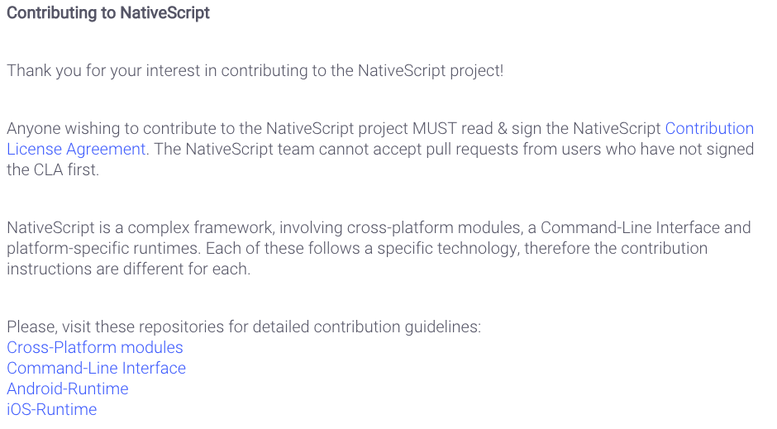
Contribute! (nativescript.org/contribute)

Slide 10





Bridge

Slide 11
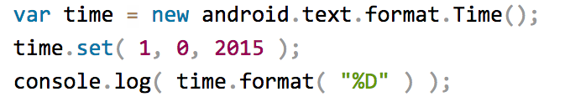
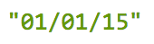
NativeScript Android example
Output:
Notes:
I'll give your brain a minute or two to parse this, because yes, this JavaScript code instantiates a Java android.text.format.Time() object, calls its set() method, then logs the return value of its format() method, which is the string "01/01/15".

Slide 12
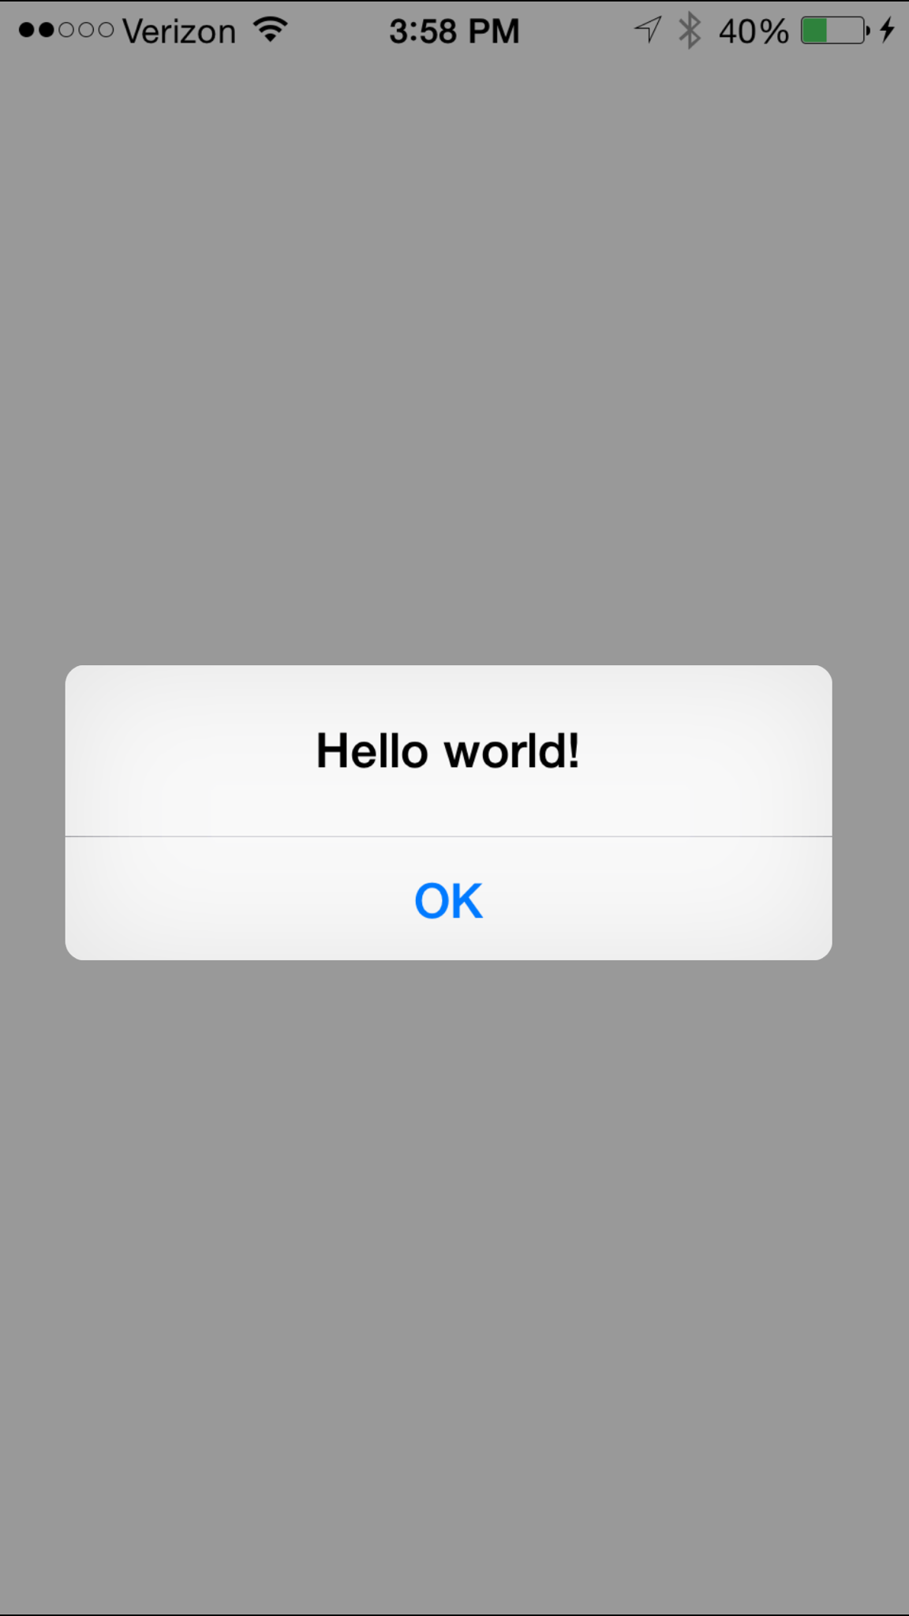
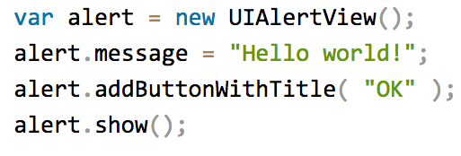
NativeScript iOS example
Notes:
This JavaScript code instantiates an Objective-C UIAlertView class, sets its message property, and then calls its addButtonWithTitle() and show() methods. When you run a NativeScript iOS app with this code you'll see the alert below:

Slide 13
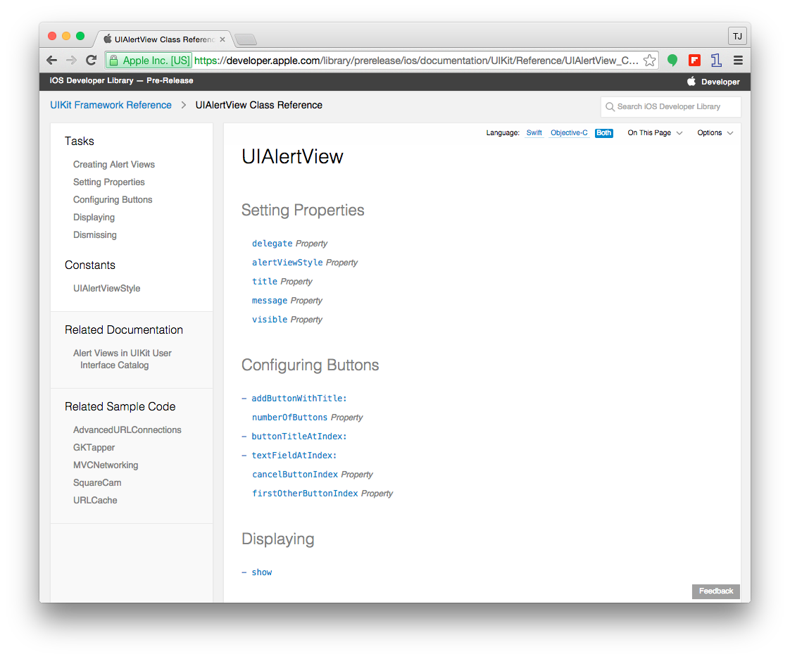

Slide 14

How does this work?

Slide 15
NativeScript and JS VMs
NativeScript runs JavaScript on a JavaScript VM
JavaScriptCore on iOS
V8 on Android

Slide 16
Runs on V8
Runs on JavaScriptCore

Slide 17
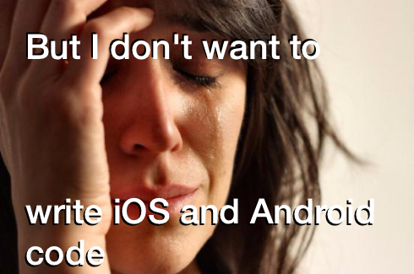

Slide 18
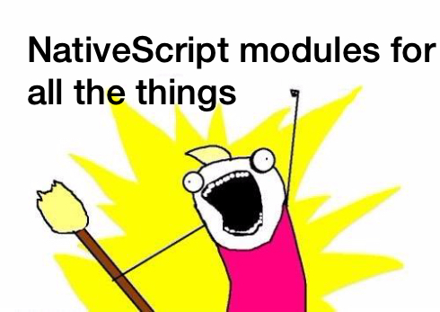

Slide 19
NativeScript modules
NativeScript-provided modules that provide cross-platform functionality.
There are dozens of them and they’re easy to write yourself.
NativeScript modules follow Node module’s conventions (CommonJS).

Slide 20
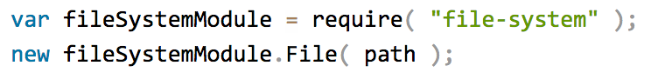
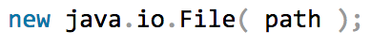
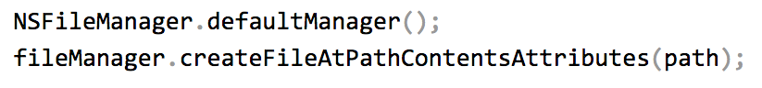
NativeScript file module

Slide 21
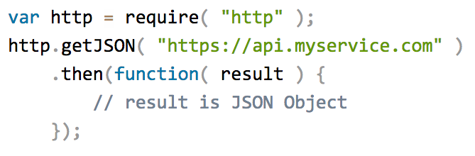
HTTP module example

Slide 22
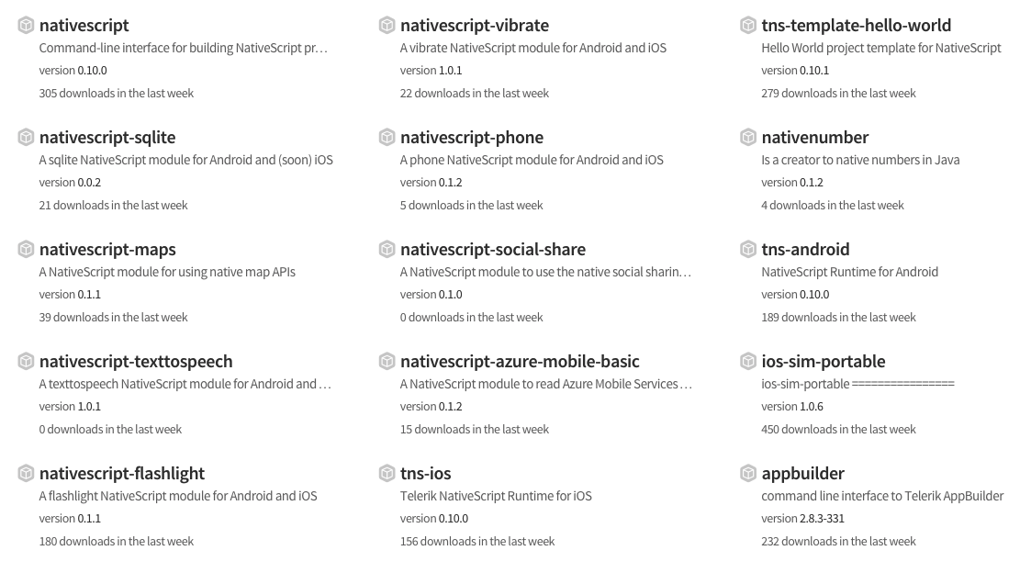
Community modules
https://www.npmjs.com/search?q=nativescript

Slide 23

But how do I turn this into an app?

Slide 24

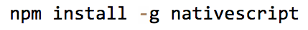
Two ways to use NativeScript
1)
2)

Slide 25
http://telerik.com/platform
Backend-as-a-service
Push notifications, cloud data, file storage, and more
Analytics
AppBuilder
Cloud builds (build iOS apps on Windows, Windows Phone apps on a Mac)
NativeScript debugging and tooling
Automated app testing
And more!

Slide 26
Telerik AppBuilder IDE Options
In-Browser Client
Visual Studio Extension
Sublime Text Package
Command-Line Interface

Slide 27
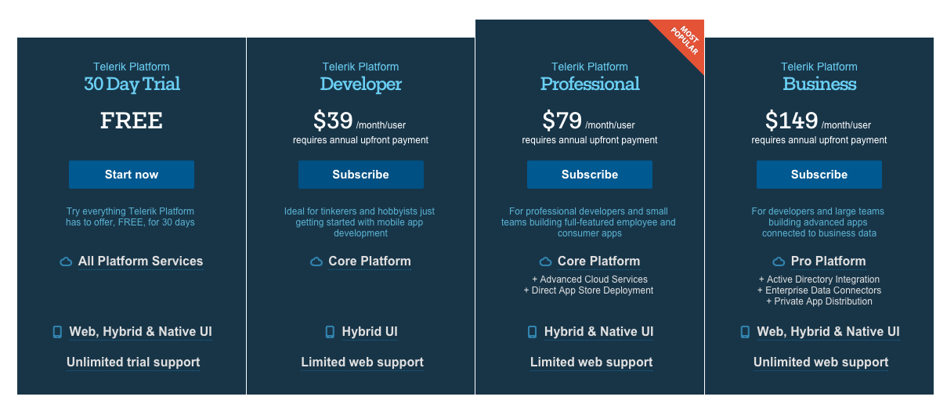
https://www.telerik.com/purchase/platform

Slide 28
NativeScript CLI
Free and open source
https://github.com/nativescript/nativescript-cli

Slide 29
NativeScript CLI requirements
https://github.com/nativescript/nativescript-cli#system-requirements
JDK, Apache Ant, Android SDK
Xcode, Xcode CLI tools, iOS SDK

Slide 30
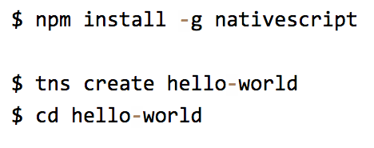
Starting a new project

Slide 31
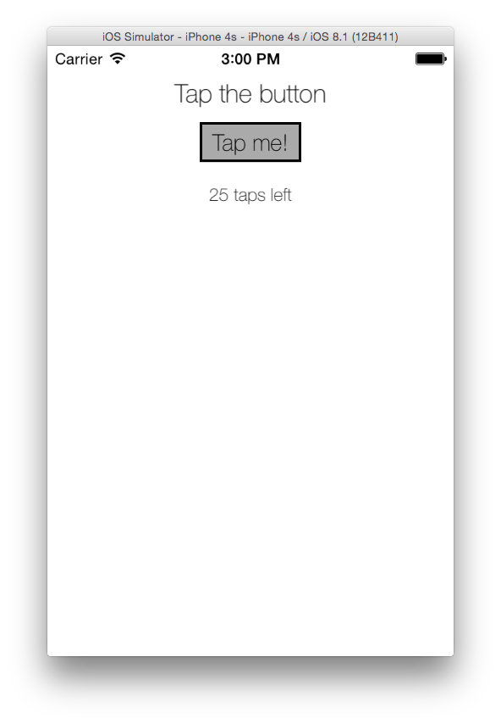
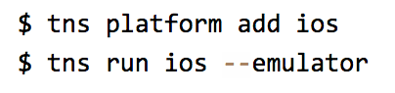
Running on iOS

Slide 32
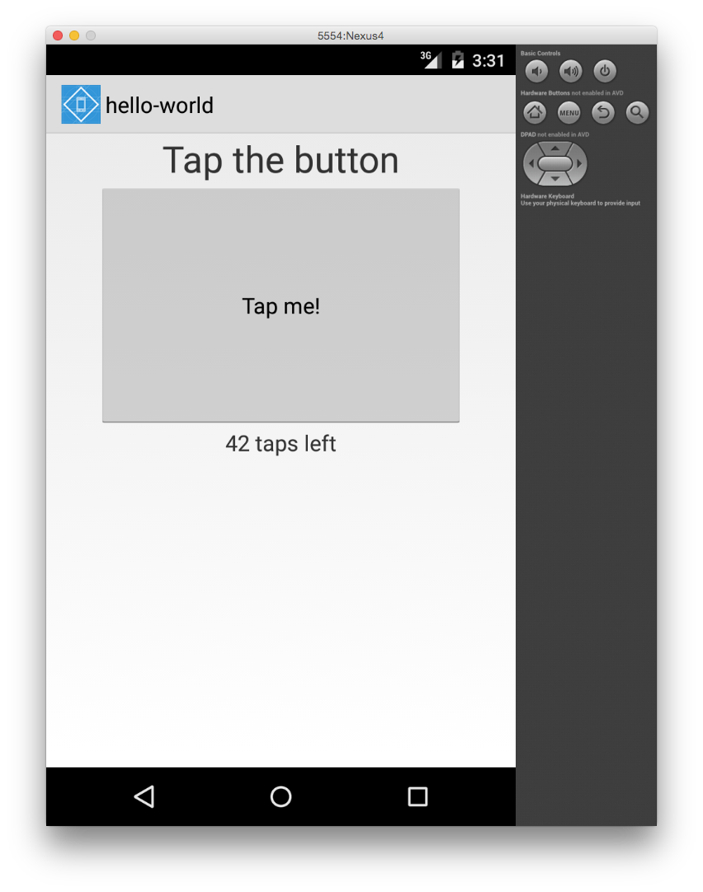
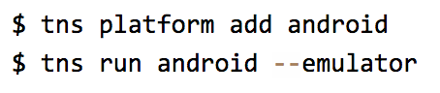
Running on Android

Slide 33
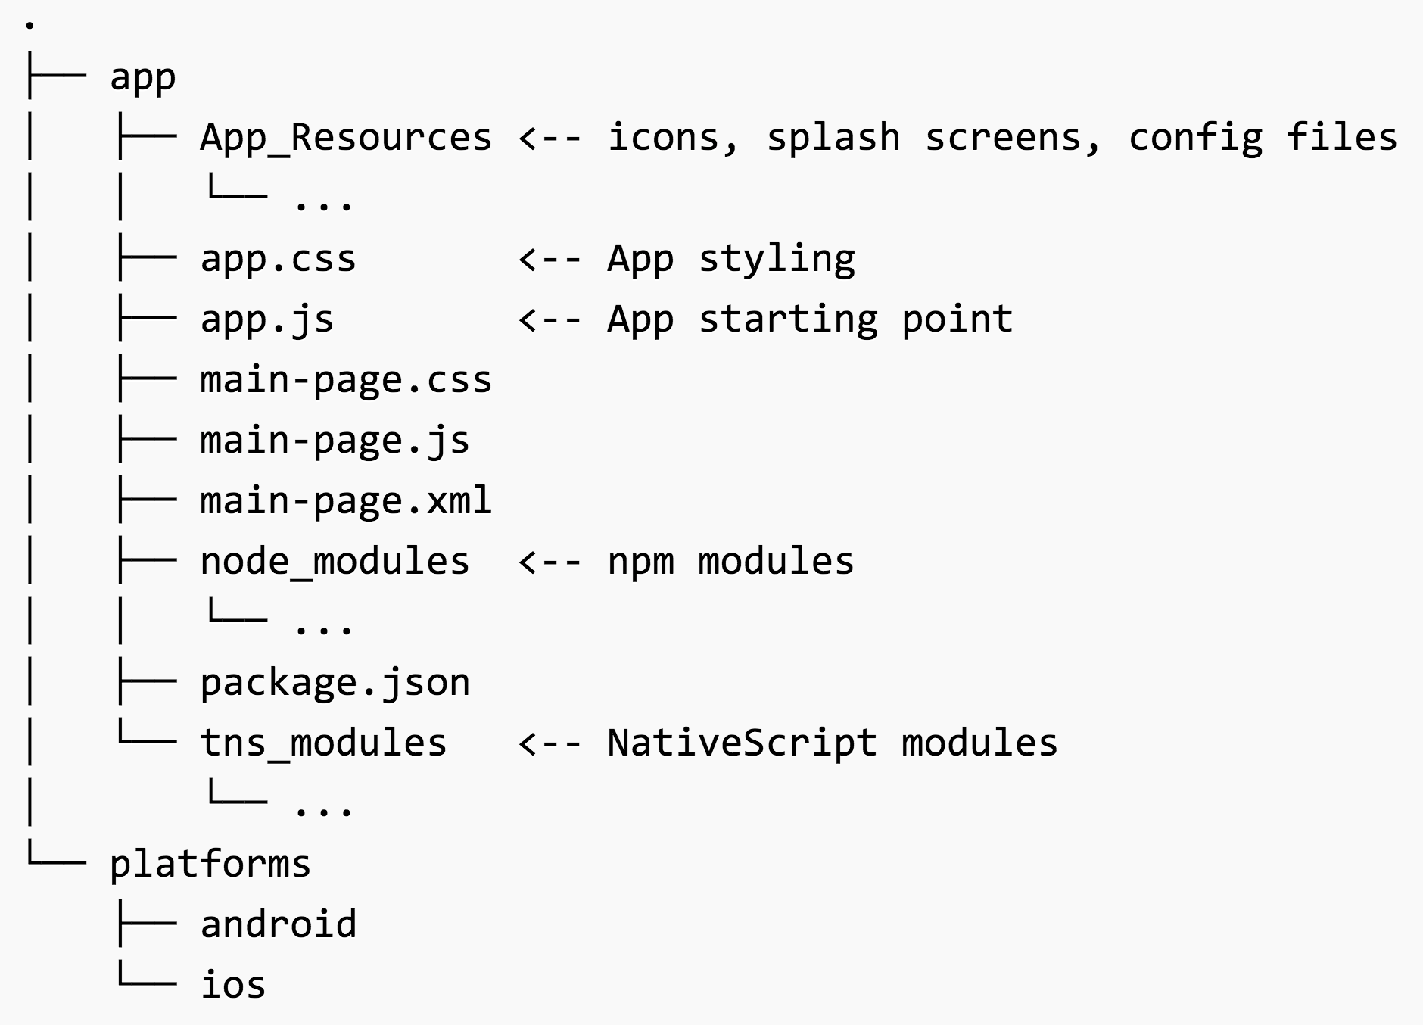

Slide 34
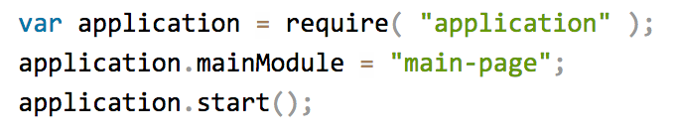
app.js

Slide 35
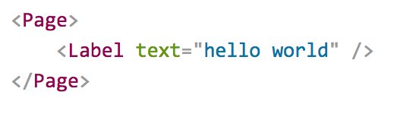
Pages
XML markup structure
Elements (e.g. <Page>, <Label>) are NativeScript modules

Slide 36
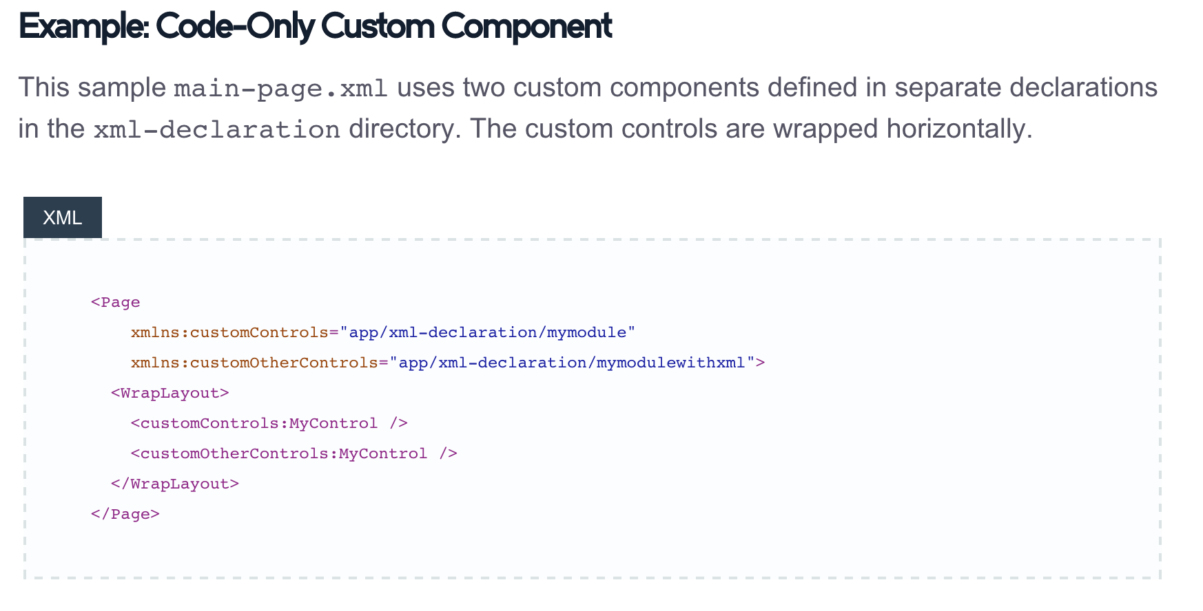
Custom XML Components
http://docs.nativescript.org/ui-with-xml#custom-components

Slide 37
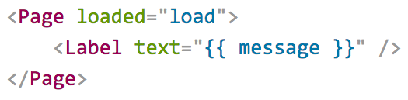
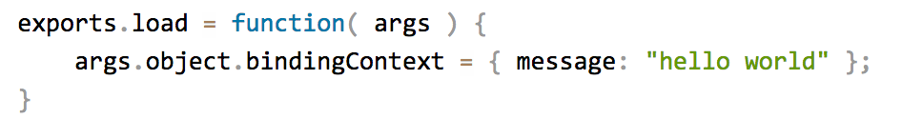
Data binding

Slide 38
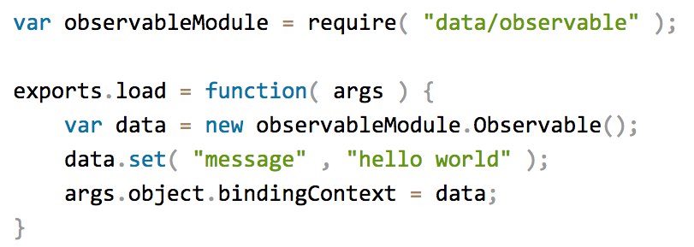
Data binding improved

Slide 39
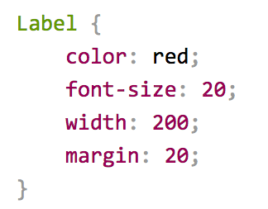
CSS

Slide 40
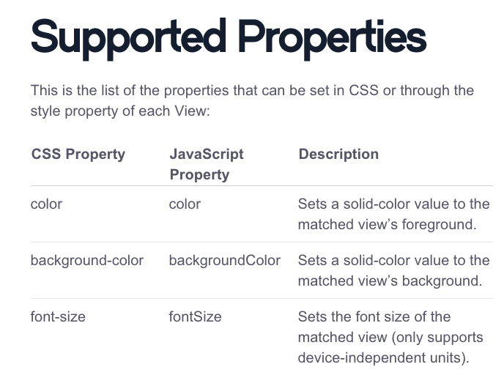
http://docs.nativescript.org/styling#supported-properties

Slide 41
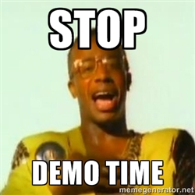

Slide 42
Hands-on Lab
https://github.com/tjvantoll/summer-of-nativescript/blob/master/july/lab.md

Slide 43
Follow NativeScript
nativescript.org
@nativescript
nativescript.org/blog

